Slide 1


Predicting High Need End-of-Life in
Medicare Patients through Machine Learning

Slide 2
Introduction
Medicare patents consume significant healthcare resources 6-12 months before they die
Estimates¹ of cost range from 21% of Medicare expense in a year due to those who died in that year; another estimate is found to be average cost per decedent of $34,500 or about 3.5 times cost of average Medicare enrollee
Patients identified via predictive models can be targeted for palliative care at a considerably fewer resources. This approach also improves the quality of life in the few remaining months for the decedents before they expire
Hospice care in the United States is an important component of care provided to Medicare patients and this can play a significant role in reducing overall cost of Medicare population.
1. Duncan I Ahmed T Dove H Maxwell T “Medicare Cost at End-of-Life” AJHP 2019
2

Slide 3
Types of Predictive Models
Rules-based Models – these are mostly created using clinical or disease-state characteristics of the patients, say in different broad categories like Severe Risk, Moderate Risk and Low Risk. Although important as a method for decision based on patient risk, it lacks the ranking feature of which patients are at most risk to die. Lack of such ranking lends it to ineffective interventions to manage such patients
Parametric Models – various statistical models like GLM and Logistic regression have the capability to handle discrete dependent variables and estimate probability of events with parameters. Such models can be estimated once and parameters can be used multiple times and periods to quantify probability of an event such as death.
Machine Learning Models – more will be discussed over the next sections. They involve training the data repeatedly to develop algorithms and publish results.
3

Slide 4
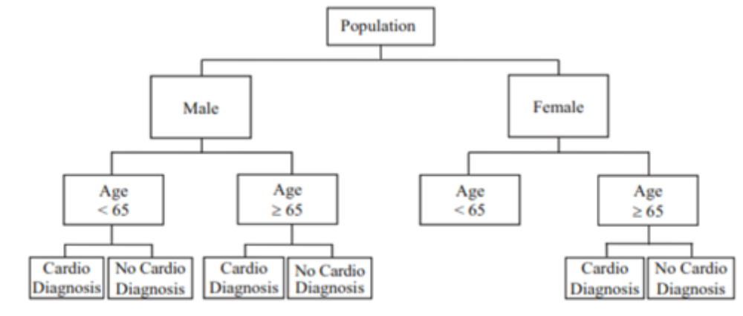
ML Model – Decision Tree
This approach is non-parametric
Process starts with splitting choices progressively
Outcome for each node is calculated by using expected value formula using the probability of a split multiplied by the number of events
4

Slide 5
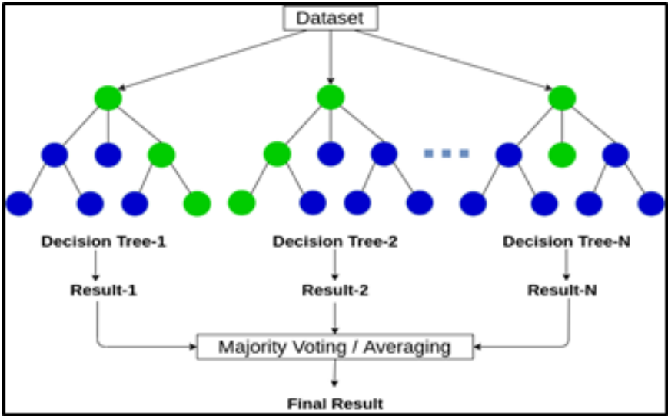
ML Model – Random Forest, Random Tree
This approach is an extension of decision tree in multiple forms
Process generates n-trees from one tree
Outcome is an average of various trees, resulting in lower variance and better predictions of the target outcomes
Random Tree is almost like Random Forest but it selects attributes from a subset of trees instead of using all the trees
5

Slide 6
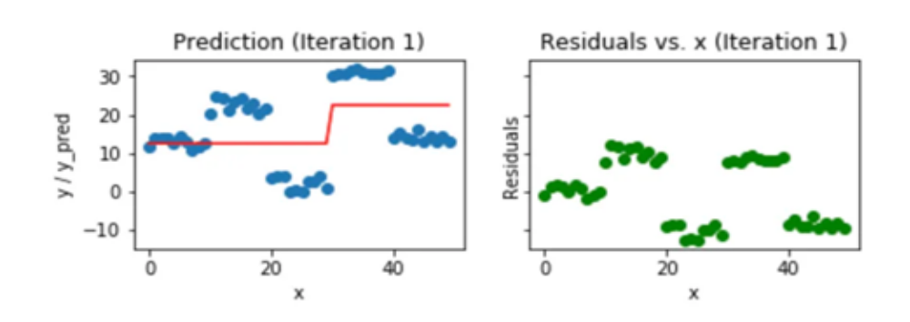
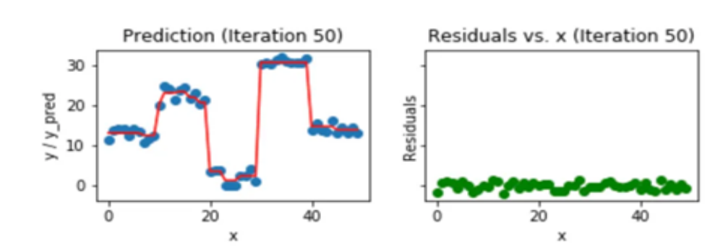
ML Model – Gradient Boosted Trees
This approach is an extension of decision tree
Each successive tree in this model improves prediction
Outcome is achieved when the residual noises are minimized
6

Slide 7
ML Model – Naïve Bayes
This approach borrows from Bayes’ Rule
Technique estimates probability of each outcome given a priori knowledge of certain events preceding it
Expected value is estimated by posterior probabilities of various outcomes
P(A|B) = P(A⋂B) / P(B) = P(A) . P(B|A)/P(B)
where:
P(A) = The probability of A occurring; P(B) = The probability of B occurring
P(A|B) = The probability of A given B; P(B|A) = The probability of B given A
P(A⋂B) = The probability of both A and B occurring
7

Slide 8
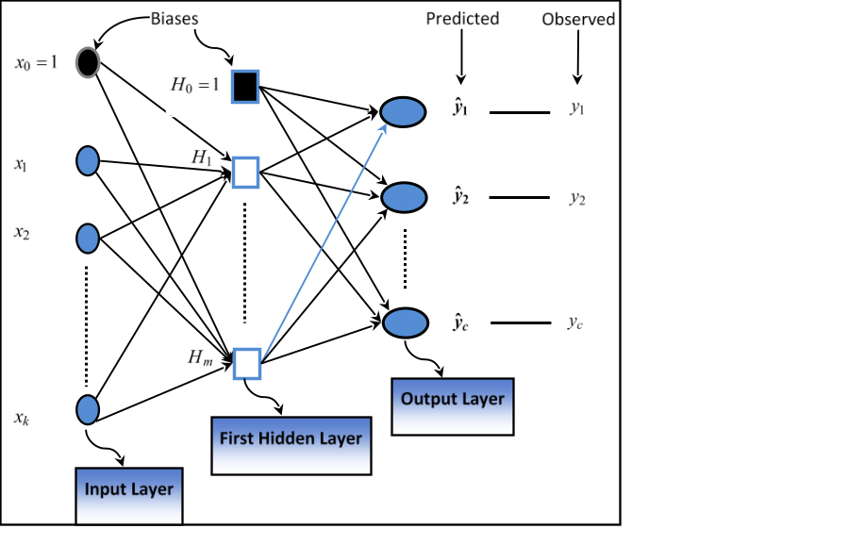
ML Model – Neural Net, Deep Learning
Neural net uses various hidden layers to pass the inputs
Hidden layers create weights which is applied to various combination of inputs
Expected value is derived when a trained data is passed through the input layers to the hidden nodes transforming to the output layer
Deep Learning is based on artificial neural networks but is a more expansive version of it
8

Slide 9
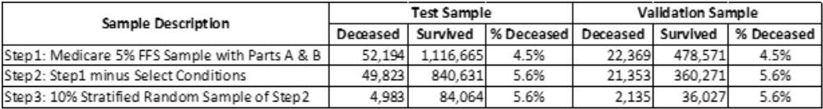
Data for Modeling
Step 1 - CMS’s Limited Data Set 5% Sample for Years 2015-16
Step 2 – Reduced sample by selecting certain conditions with higher probability of death
Step 3 – Stratified Random Sampling @10%
We chose people who have at least 6-months of data prior to death event or those who survived
9

Slide 10
Data for Modeling – Variables Used in Models
DEPENDENT VARIABLE
Members who died between Apr-Dec, 2016
Members who survived during that same period
Both dead and survived members must have a list of conditions - Septicemia, Sepsis, Systemic Inflammatory Response Syndrome/Shock, Cardio-Respiratory Failure and Shock, Congestive Heart Failure, Specified Heart Arrhythmias (SRA), Chronic Obstructive Pulmonary Disease, Acute Renal Failure, various cancers, patients using anticoagulants, depression, GERD, kidney diseases, malaise, metal, nicotine, orthopedic conditions, pneumonia, CHF % renal and CHF & SRA
INDEPENDENT VARIABLES
Age/Sex Bands – 5 bands for male and 5 bands for female
Race – 6 flags
Region – 5 flags
HCC – 79 flags based on CMS Medicare risk grouper
Additional 5 HCC conditions, 15 comorbid conditions
Additional 24 clinical conditions
Discharge indicator to Home/Self-care
Hospital readmission
ICU before death flag in 30 days, ICU before Hospice admission
Charlson Co-morbidity Index [20]
Hospice Admission count 3-month and 6-month prior to death
Inpatient Admission count 3-month and 6-month prior to death
SNF Admission count 3-month and 6-month prior to death
Transition of Care count 3-month and 6-month prior to death
30-day Readmission counts over 6-month prior to death
ER Visit count 3-month and 6-month prior to death
ER Trauma Admissions 3-month and 6-month prior to death
Hospital Admission via ER flag
Total PMPM of Patient, square root of PMPM and square of PMPM
Percent cost of patients in last 3-month prior to death
Homecare DME
10

Slide 11
Model Performance
Model Performance was measured with 3 metrics
  Specificity – members who were predicted to survive actually survived
  Sensitivity – Proportion of members with probabilities exceeding 50%
  Positive Predictive Probability – this is a measure of the ratio of people predicted to die with p>50% as a proportion of all members
11

Slide 12
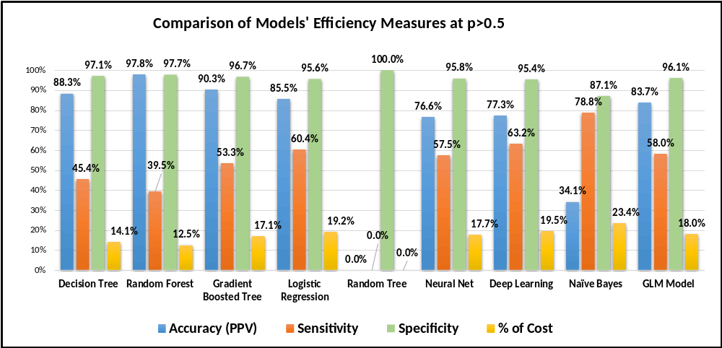
Model Performance
Graph shows comparative statistics of various models
Specificity is pretty high in all models
Sensitivity varies widely with Random Tree at the lowest level and Naïve Bayes at the highest level
Accuracy or PPV varies widely too, with the highest at Random Forest followed by Gradient Boosted Tree and Decision Tree.
12

Slide 13
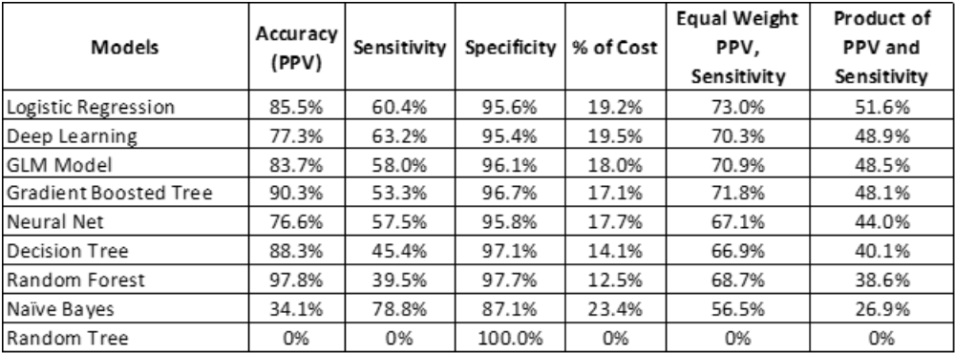
Model Performance
The table shows the same statistics as was presented on the graph.
We also calculated percent of cost as represented by the relevant population slices
Naïve Bayes model’s ability to identify the population with high needs also shows a high percent cost associated with its identified group
13

Slide 14
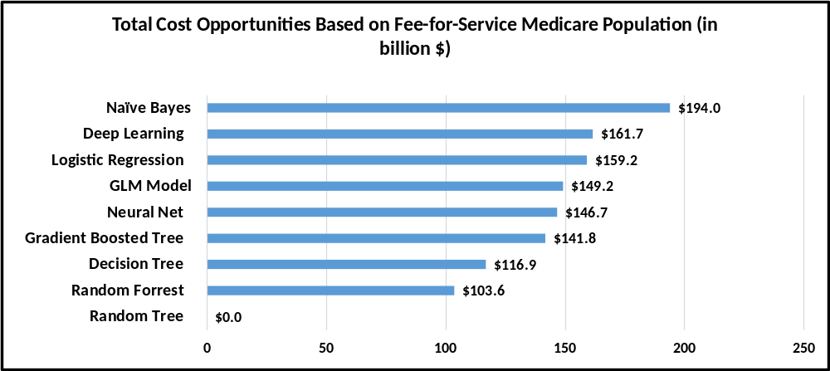
Program Development
Figure shows opportunities of this model in Medicare population
Based on Medicare expenditure of $829 billion in CY2021, we estimated the potential savings from different models
Although Naïve Bayes model has an ability to identify largest potential savings, but due to its low PPV we favor Logistics regression or Deep Learning models as a better predictor with lower cost of interventions
14

Slide 15
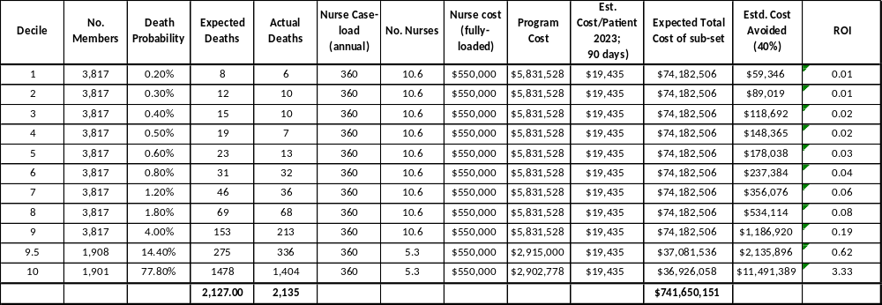
Economic Model for Planning EOL Intervention Program
Table shows opportunities of this approach in Medicare population, particularly in estimating ROI
Table is arranged by deciles of population where actual deaths and expected deaths were estimated from underlying data
Cost of intervention is estimated by taking into account direct nurses and indirect program cost annually
Only the highest vigintile has the relevant ROI exceeding 3.3
15

Slide 16

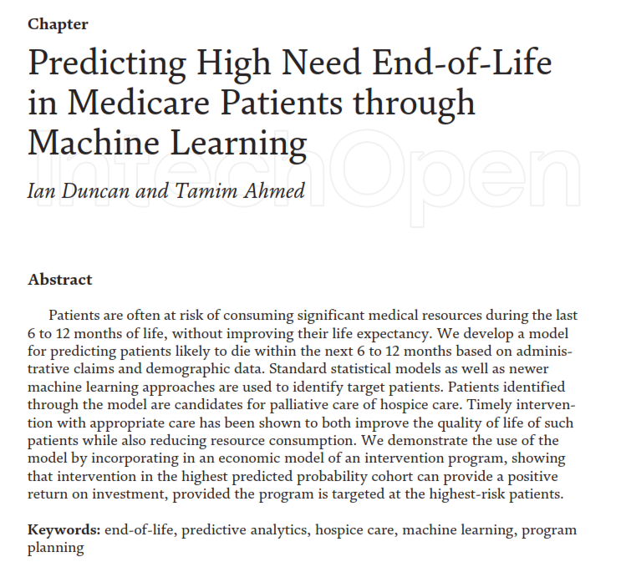
Economic Model for - Publication
16
16

